Slide 1
Facilities Services
Guide to Services Draft Review
Adam Schnirel
Associate Vice Chancellor
May 2023

Slide 2

UCR Facilities Services
FS Mission Statement
To maintain, operate, and support the University of California, Riverside campus and infrastructure to ensure a safe, and environmentally sustainable environment for education, research, and discovery.
Vision
To create an environment of innovation that supports high quality service through a culture of
respect, integrity, and diversity.
Values
Respect: Treat others as you would like to be treated.
Integrity: Do what you say and say what you do.
Diversity: Celebrate each other’s differences and seek to learn from new perspectives.
2

Slide 3
What We Support
Client Support Services
Client Support Services aims to deliver extraordinary service and accurate information to everyone on campus so Facilities Services can provide a safe, healthy, growing, learning and living environment. Our mission is to be the premiere source of trusted, accurate, and timely information about the work we do for all who inquire.
Environmental Resource Services
Environmental and Resource Services provides a clean, safe and aesthetically pleasing environment for all members of the campus community to live, learn and work.
Energy & Engineering
Energy and Engineering aims to advance UC Riverside's energy and utility infrastructure, energy procurement, energy efficiency, energy renewables and campus-wide sustainability goals to make UC Riverside number one in energy management & sustainability.
Maintenance Services
Maintenance Services provides quality maintenance and repair services in a timely, cost effective manner for all campus facilities.
3

Slide 4
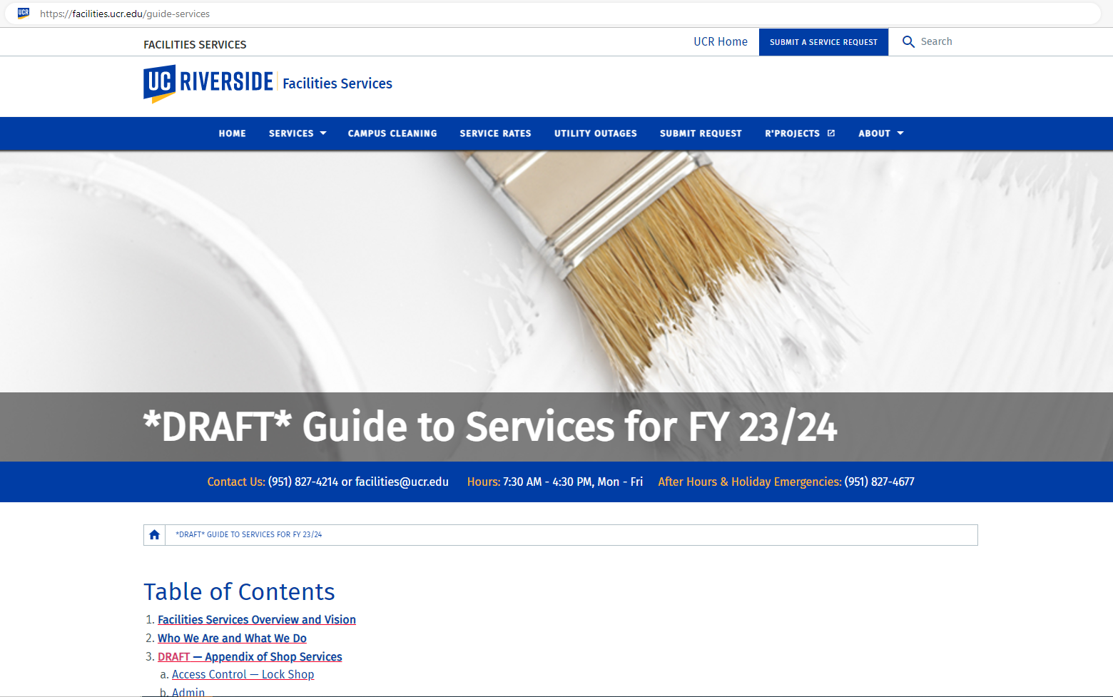
Guide to Services
https://facilities.ucr.edu/guide-services
4

Slide 5
Important Service Changes
Change | Impact | Status
Access Controls | Recharge costs* for key/fob creation Mullion removal Master key limitations See new key policy here | Implemented Jan 1, 2023
Event Setup | Recharge cost* for all event setup support | FY 23/24
Moves of Equipment and Office Items | Recharge cost* for all move requests supported by FS | FY 23/24
FS Projects | All paint and renovation requests for department-occupied spaces which are not in support of new faculty hires will be recharge and include FS’s newly expanded project management support | FY 23/24
Carpentry | Recharge cost* for all requests for seismic restraints, furniture bracing, keyboard tray installation, wall mounts, televisions, art installs, etc. | FY 23/24
Sign Shop | Changes to supported services — wayfinding, nameplates, etc. | Implemented FY21
Utilities | Connections to support new equipment, new electrical, etc. — non-new faculty — will be recharge cost | FY 23/24
5

Slide 6
Why Change?
Focus on Maintenance
UCR campus buildings are in need of significant repair and attention
Our new Preventative maintenance program will help prevent unplanned asset and system failures/outages
Build Consistency
Alignment with other UC’s
Clear expectations for FS staff and Campus
Provide Improved Service
Adjustments to service level timelines
Focus on common area and restroom improvements
Cost
Limited resources within FS to provide free services
Free service costs the Campus in the long run
6

Slide 7
FS Service Level Prioritization
Service Level 1 | Urgent Skilled trade response within 0-4 hours Emergency work posing a risk to life, safety, and property.
Service Level 2 | Immediate Skilled trade response within 2 days Work required to mitigate imminent threats to research, instruction, or safety.
Service Level 3 | Essential Skilled trade response within 7-business days Work required to ensure continuity of general instruction/research mission.
Service Level 4 | Normal Skilled trade response within 15-business days Maintenance and repair work required impacting campus operations.
Service Level 6 | Recharge Requests Initial visit and scoping review within 21-business days Funded by the requestor, a recharge request is a net-new item request of a small scale, such as adding ergonomic keyboard trays or the addition of single electrical circuit.
Facilities Services processes approximately 40,000 service requests along with thousands of calls and emails on an annual basis. Our goal is to assign all incoming requests to the appropriate skilled-trade team the same day it is received, Monday - Friday.
7

Slide 8
New Program
Interior Common Space Makeover Program
FS will engage with the campus community regarding improvement suggestions via our newly developed Interior Common Space Makeover Program. The vision of this program is to improve high-volume, common, campus locations selected from previous and new improvement submissions from campus faculty, students, and staff for the interior finish remodel of common spaces, such as restrooms, lobbies, and hallways. Final selections via public voting will be funded by Facilities Services with work to commence in the summer and fall of 2023.
8

Slide 9
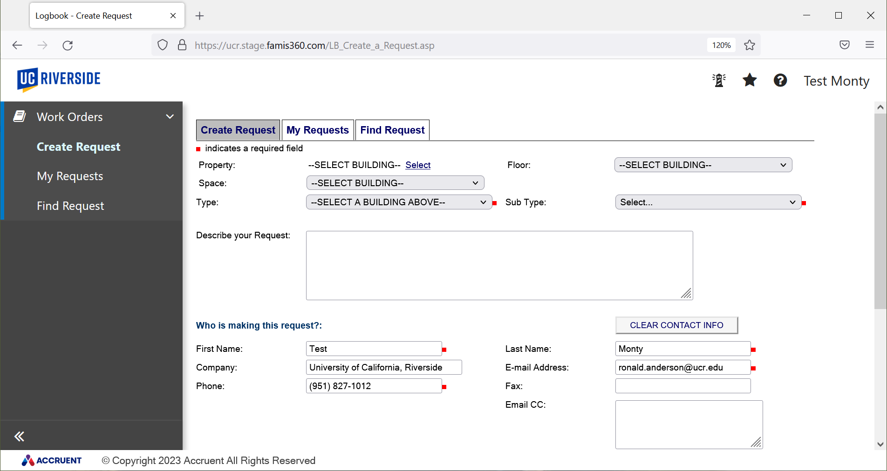
New Work Order System
SSO login.
Create requests with easier dropdown / freeform functionality, Cc recipients, and attach files.
Review requests with easier search and watchlist functionality.
9

Slide 10
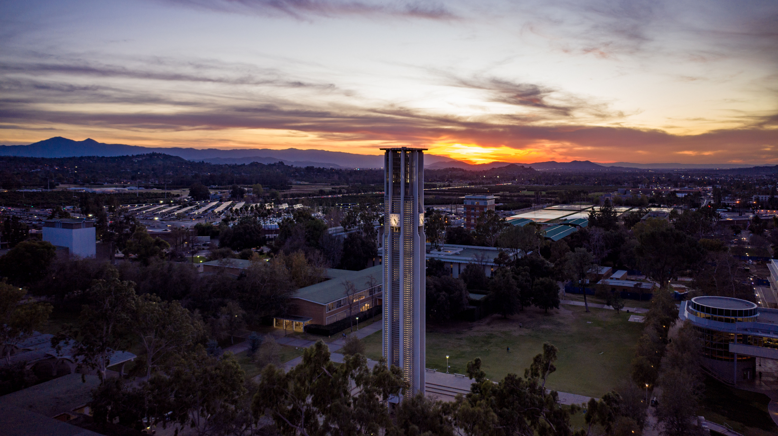
Q & A
10

